Slide 1
MicroFluigis
Ryan Silva
Mark Wang

Slide 2
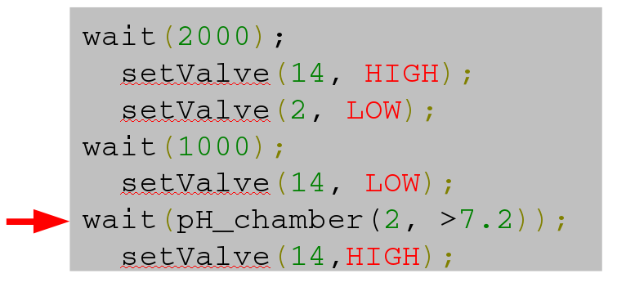
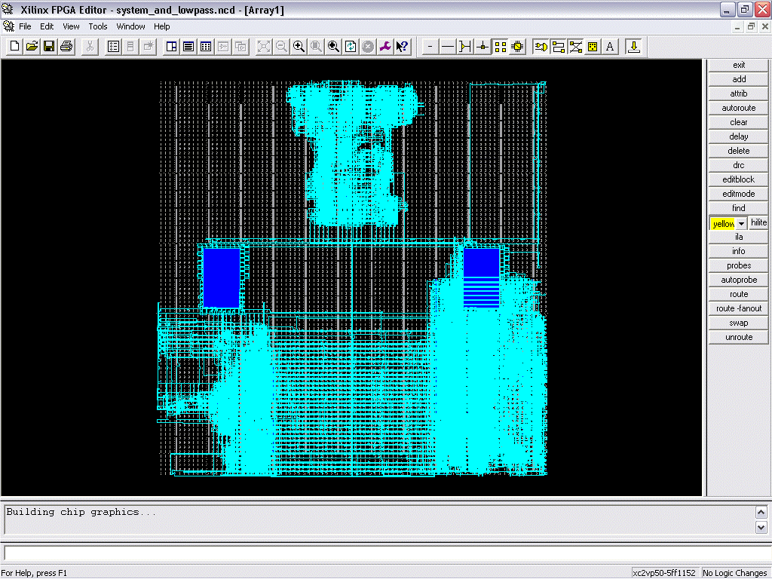
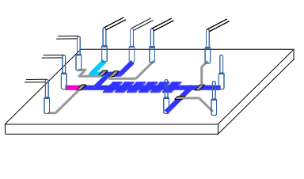
Goal/Motivation
Notes:
Bring the computational power of the FPGA to the uF domain

Slide 3
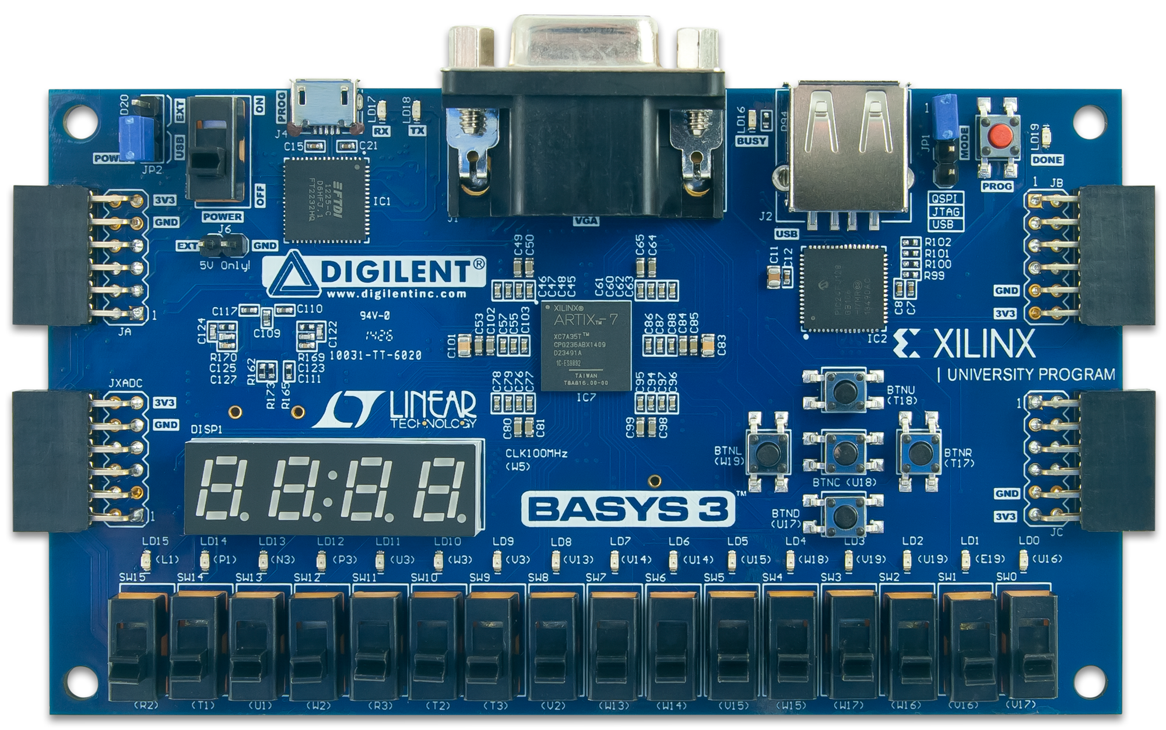
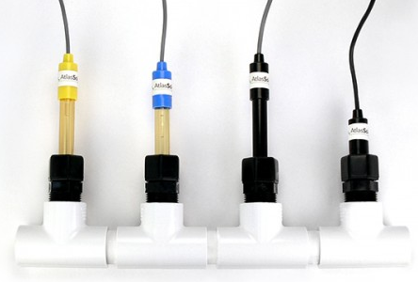
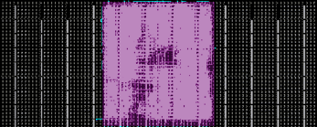
Functionality What did we do?
Dynamic Reconfiguration
Parallel Processing

Slide 4
Specification How did we test to see if it works?
Dynamic Reconfiguration
Parallel Processing
Bound Reconfigurable Partitions
Out-of-context (OOC) synthesis
Partial bitstream generation
Automated process
Simultaneously read two sensors
Send serial commands to two sensors

Slide 5
Detailed Functionality Dynamic Reconfiguration
Dynamic Reconfiguration
Partial Reconfiguration
Reconfiguration
Overhead
Configuration
Overhead
Reconfiguration
Overhead
Configuration
Overhead
Function
Function
Power On
Shut
Down
Power On
Shut
Down
Time
Time
Figures from Xilinx UG909

Slide 6
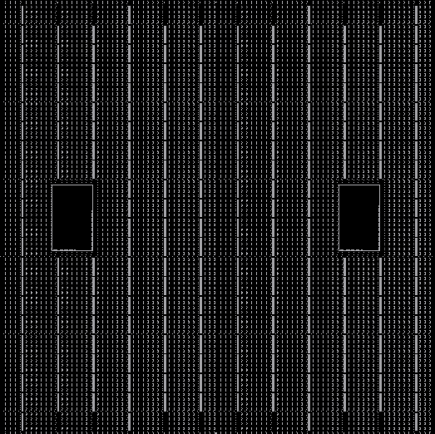
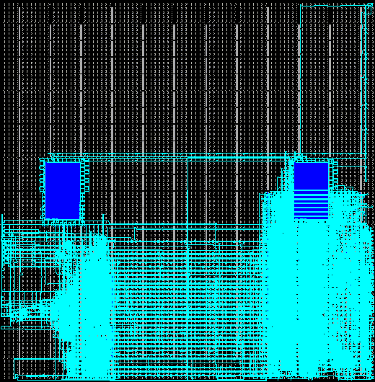
Detailed Functionality Dynamic Reconfiguration (Silva)
Dynamic Reconfiguration
Partial Reconfiguration
Figures from Xilinx UG909
Reconfiguration
Overhead
Configuration
Overhead
Configuration
Overhead
Reconfiguration
Overhead
Function
Function
Power On
Shut
Down
Power On
Shut
Down
Time
Time

Slide 7
Detailed Functionality Dynamic Reconfiguration (Silva)
Reconfigurable Partitions
Reconfigurable Modules
A1
RP “A”
A2
A3
RP “B”
B1
B2
RP “C”
C1
Static
C2
C3
C4
Figures from Xilinx UG909

Slide 8
Detailed Functionality Dynamic Reconfiguration (Silva)
Traditional
Reconfigurable
HDL Design
Top-Down Synthesis
Netlist Linking and Constraints
Packing, Placement, Optimization
Routing, Post-Route Optimization
Static Timing Analysis
DRC and Bitstream Generation
HDL Design/System Planning
Bottom-Up Synthesis
Static Synthesis
RM Synthesis
Constrain Reconfigurable Resources
Physical Blocks
RM Timing
Partition Pins
PR Implementation
RP-Static Linking
RP-Static Optimization
Implementation
In-Context
Full Design Constraints
DRC and Bitstream Generation

Slide 9
Detailed Block Diagrams Dynamic Reconfiguration (Silva)
design.tcl
run.tcl
log.tcl
step.tcl
design_utils.tcl floorplan_utils.tcl impl_utils.tcl synth_utils.tcl
synth.tcl
impl.tcl
ooc_impl.tcl
pr_impl.tcl
$ vivado -mode tcl
% source design.tcl

Slide 10
Verilog Example Dynamic Reconfiguration (Silva)
###############################################################
### Define Part, Package, Speedgrade
###############################################################
set device "xc7a35t"
set package "cpg236"
set speed "-1"
set part $device$package$speed
###############################################################
### Setup Variables
###############################################################
####flow control
set run.topSynth 1
set run.rmSynth 1
set run.prImpl 1
set run.prVerify 1
set run.writeBitstream 1
####Report and DCP controls - values: 0-required min; 1-few extra; 2-all
set verbose 1
set dcpLevel 1

Slide 11
Verilog Example Dynamic Reconfiguration (Silva)
####Output Directories
set synthDir "./Synth"
set implDir "./Implement"
set dcpDir "./Checkpoint"
set bitDir "./Bitstreams”
####Input Directories
set srcDir "./Sources"
set rtlDir "$srcDir/hdl"
set prjDir "$srcDir/prj"
set xdcDir "$srcDir/xdc"
set coreDir "$srcDir/cores"
set netlistDir "$srcDir/netlist”
###############################################################
### Top Definition
###############################################################
set top "top"
set static "Static"
add_module $static
set_attribute module $static moduleName $top
set_attribute module $static top_level 1
set_attribute module $static vlog [list [glob $rtlDir/$top/*.v]]
set_attribute module $static synth ${run.topSynth}

Slide 12
Verilog Example Dynamic Reconfiguration (Silva)
####################################################################
### RP Module Definitions
####################################################################
set module1 ”Your-Module1-Here"
set module1_variant1 ”Your-Module1-Variant1-Here"
set variant $module1_variant1
add_module $variant
set_attribute module $variant moduleName $module1
set_attribute module $variant vlog [list $rtlDir/$variant/$variant.v]
set_attribute module $variant synth ${run.rmSynth}
set module1_variant2 ”Your-Module1-Variant2-Here"
set variant $module1_variant2
add_module $variant
set_attribute module $variant moduleName $module1
set_attribute module $variant vlog [list $rtlDir/$variant/$variant.v]
set_attribute module $variant synth ${run.rmSynth}
set module1_inst "inst_Your-Module1-Here”

Slide 13
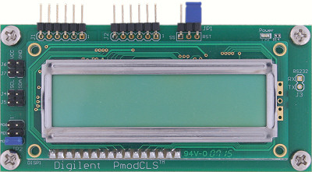
Detailed Functionality Parallel Processing (Wang)
LCD_interface – SPI_Tx (switch controlled)
FST is used to correctly transfer data and switch in single or continuous display mode
Buffer – LCD_interface:
FST is used to insert data into LUT
Pmod – UART – Buffer:
4 UART receivers with independent buffer attached
Shift register are used for saving data for 7 Seg
Sensor – Pmod:
4 pin for every sensor: DCC, GND, Tx, Rx
SPI Tx
LCD LUT
7 Segment Display
Register
Buffer
UART
Pmod Connector
Color
Sensor

Slide 14
Detailed Block Diagrams Parallel Processing (Wang)
LCD LUT
SPI Tx
7 Segment Display
Led
Register
Buffer
Buffer
Buffer
Buffer
Switch
UART
UART
UART
UART
Pmod Connector
Color
Sensor
Color
Sensor
Color
Sensor
Color
Sensor
Notes:
14

Slide 15
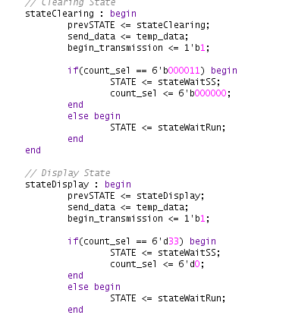
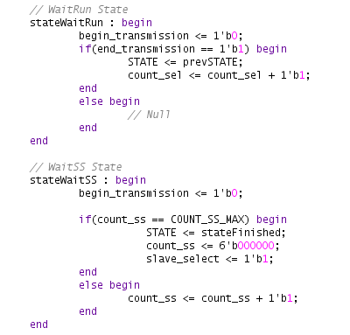
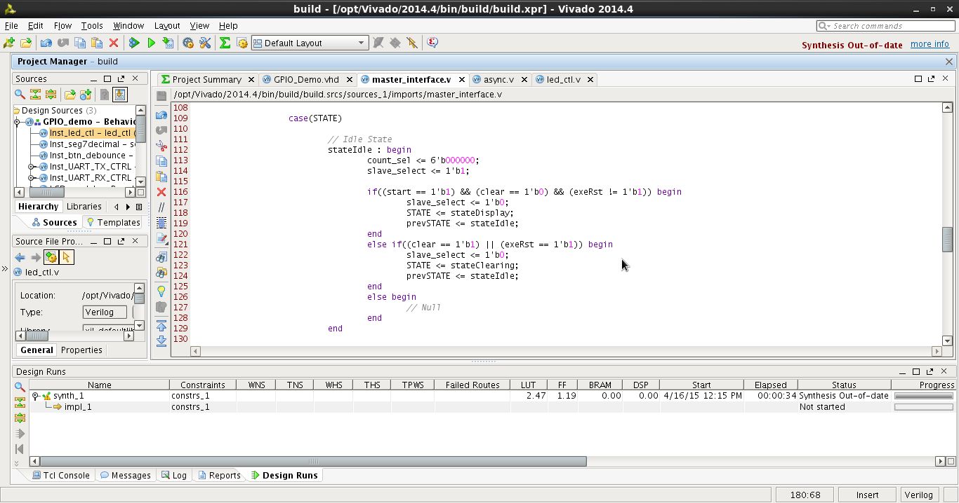
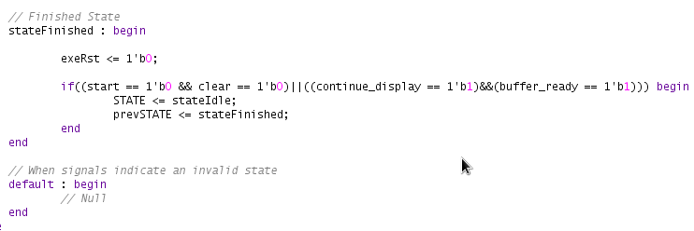
Verilog Example Parallel Processing (Wang)
State_
Idle
State_
Finished
State_
Display
Start = 1
Clear = 0
1
1
Start = 1
Clear = 0
Send data
0
Count_sel = 33
0
0
0
exeRst = 1
Clear = 1
0
continue = 1
Data_rdy = 1
1
1
1
State_
Clear
State_
waitSS
Send data
State_
waitRun
0
Count_sel = 3
0
Count_ss = MAX
Previous State
1
1
Notes:
15

Slide 16
Successes
Set-and-forget partial reconfiguration script
Learned TCL
Demonstration of FPGA’s unmatched uF potential
Parallel sensing
Soon-to-be parallel control

Slide 17
Failures
Unable to fabricate chips
Fabrication process is brand new
Unable to print the syringe pump
CIDAR’s generalized 3D-Printer out of commission

Slide 18
Design Tradeoff
Original Proposal:
Microfluidic Control (Mandatory)
Microfluidic Instrumentation (Mandatory)
Dynamic Reconfiguration (Nice-To-Have)
Fog of War
No syringe pump
No microfluidic chip
Modified Proposal:
Extensible Framework for uF Instrumentation
Automated Dynamic Reconfiguration

